Slide 1

Insurance Premium & Payout KPI Dashboard
A Unified Analysis by Basavaraj — Junior Data Analyst

Slide 2

Introduction: Transforming Scattered Data into Actionable Insights
As a Junior Data Analyst, I embarked on a mission to transform disparate insurance datasets into a cohesive, insightful Power BI dashboard. Initially, I was presented with a variety of raw, disconnected data sources, each containing critical but isolated information: customer demographics, intricate policy details, historical premium payments, detailed underwriting expenses, individual agent performance metrics, and crucial future maturity values.
My primary task was ambitious yet essential: to meticulously clean, unify, and model this vast ocean of data. The ultimate goal was to convert this raw, unstructured information into a single, intuitive Power BI dashboard, providing a holistic view of the company's insurance operations.

Slide 3
The Challenge: Overcoming Data Fragmentation
Scattered Data Landscape
Limited Strategic Overview
The company faced significant operational hurdles due to critical business data being scattered across numerous, disconnected sources. This fragmentation led to a severe lack of comprehensive visibility into key performance indicators.
Inability to track actual premium paid versus projected payable amounts.
Difficulty in identifying best-performing and underperforming policy types.
Lack of insights into evolving customer behavior patterns.
Operational Blind Spots
The Solution: Unified Dashboard
No clear visibility into state-wise performance and regional discrepancies.
To address these critical pain points, I developed a singular, unified Power BI dashboard. This solution integrates all data streams, providing leadership with a 360-degree view of the insurance business and enabling data-driven decision-making.
Challenges in quantifying individual agent contributions and effectiveness.
Absence of foresight regarding future maturity payout obligations.

Slide 4







Diverse Data Sources: The Foundation of Our Analysis
Customer Details
Policy Details
Policy Type
Comprehensive records of policyholders, including demographics and contact information.
In-depth information on each insurance policy, such as coverage, terms, and conditions.
Categorization of policies by product offerings (e.g., life, auto, health, whole life, ULIP).
Payment Data
Sales Agent
Regional & Zonal Manager
Records of all premium payments, including dates, amounts, and payment methods.
Performance metrics and details for individual sales representatives.
Data related to management hierarchy and regional performance.
Underwriting Expenses
Detailed breakdown of costs associated with policy underwriting and administration.

Slide 5

Data Refinement: Cleaning and Modeling for Accuracy
Null and Duplicate Removal: Implemented robust data cleansing techniques to identify and eliminate null values and duplicate entries, ensuring data integrity and accuracy.
Standardized Date Formats: Applied consistent date formatting across all datasets, crucial for accurate time-series analysis and reporting.
Relationship Creation (Star Schema): Developed a powerful Star Schema data model, establishing clear and efficient relationships between various data tables. This structure optimizes query performance and simplifies complex analysis.
Calculated Columns: Introduced new calculated columns to derive additional meaningful attributes from existing data, enriching the dataset for deeper insights.
DAX Measures Development: Crafted sophisticated Data Analysis Expressions (DAX) measures for key financial metrics, including Total Premium, Premium Payable, Maturity Values, and Return on Investment (ROI), providing precise financial calculations.

Slide 6






KPI Summary Dashboard: Your At-a-Glance Overview
Total Policies
Total Premium Amount
Overall count of active and historical insurance policies.
Aggregate sum of all premiums across all policies.
Total Premium Paid
Total Premium Payable
Cumulative amount of premiums successfully collected to date.
Remaining outstanding premium amount due from policyholders.
Annual Premium
Underwriting Expenses
Total premium expected or collected within the current fiscal year.
Costs incurred during the process of evaluating and insuring risks.
This comprehensive KPI dashboard provides an executive-ready view, allowing stakeholders to quickly grasp the financial health and operational performance of the insurance portfolio. Each card is designed for clarity and immediate insight.

Slide 7




Maturity Amount (Complex Logic Given by GM)
This is your main highlight — include it exactly like this:
This section outlines the sophisticated DAX logic used to calculate the Maturity Amount for insurance policies. It incorporates various factors such as annual premium, policy tenure, and policy status, with special conditions for specific policy types and premium thresholds. The complexity reflects a nuanced approach to financial modeling, ensuring accurate projections based on a multi-tiered return rate structure.
Maturity Amount = VAR Premium = 'FCT Insurance_Policy_Table'[Total Anuunal Premium] VAR Tenure = 'FCT Insurance_Policy_Table'[Tenure (Years)] VAR PolicyStatus = 'FCT Insurance_Policy_Table'[Policy Status] VAR PolicyName = RELATED('DM Policy_Protection_Plan'[Policy Name])RETURN IF ( PolicyStatus <> "ACTIVE", 0, VAR IsSpecialPlan = PolicyName IN { "Future Assure Plan", "Retire Secure", "Smart Term Protect", "Guaranteed wealth Builder", "child Education Plus", "Jeevan Suraksha", "Income Protection Plan", "whole Life Shield", "ULIP Growth Plan", "Life Growth Advantage" }VAR ReturnRate = SWITCH ( TRUE (), -- SPECIAL PLAN RULE IsSpecialPlan && Premium < 40000 && Tenure <= 8, 0.08, -- PREMIUM < 40k RULE Premium < 40000 && Tenure <= 8, 0.08, Premium < 40000 && Tenure = 10, 0.04, Premium < 40000 && Tenure = 12, 0.045, Premium < 40000 && Tenure = 15, 0.05, Premium < 40000 && Tenure = 20, 0.055, Premium < 40000 && Tenure = 22, 0.06, Premium < 40000 && Tenure = 25, 0.065, Premium < 40000 && Tenure = 30, 0.08, -- PREMIUM 40k–80k RULE Premium >= 40000 && Premium < 80000 && Tenure = 10, 0.05, Premium >= 40000 && Premium < 80000 && Tenure = 12, 0.06, Premium >= 40000 && Premium < 80000 && Tenure = 15, 0.07, Premium >= 40000 && Premium < 80000 && Tenure = 20, 0.075, Premium >= 40000 && Premium < 80000 && Tenure = 22, 0.08, Premium >= 40000 && Premium < 80000 && Tenure = 25, 0.085, Premium >= 40000 && Premium < 80000 && Tenure = 30, 0.10, -- PREMIUM >= 80k RULE Premium >= 80000 && Tenure = 10, 0.08, Premium >= 80000 && Tenure = 12, 0.085, Premium >= 80000 && Tenure = 15, 0.09, Premium >= 80000 && Tenure = 20, 0.095, Premium >= 80000 && Tenure = 22, 0.10, Premium >= 80000 && Tenure = 25, 0.15, Premium >= 80000 && Tenure = 30, 0.20 )RETURN Premium * Tenure * (1 + ReturnRate)
Maturity Amount
Premium
Final computed value
Regular payment amount
Maturity Amount (Complex Logic Given by GM)
Return Rate
Tenure
Rate derived from factors
Policy duration in years
Policy Name
Policy Status
Product identifier
Active or lapsed state

Slide 8


Premium Distribution by Policy Type
Understanding which policy types drive the most premium revenue is crucial for strategic product development and marketing efforts. This chart highlights the proportional contribution of each policy category to the total premium collected.
Key Insight
Our analysis reveals that Whole Life and Universal Life plans are the primary contributors to our premium income. This indicates strong customer demand and sustained value in these product offerings.
Whole Life
Universal Life
Term Life
ULIP
Endowment

Slide 9

Top Performing Policies by Name
Delving deeper into policy performance by specific product names allows for granular understanding of market demand and customer preference. This analysis helps in prioritizing product development and marketing focus.
ULIP Growth Plan
Jeevan Suraksha
Life Growth Advantage
Key Insight
The ULIP Growth Plan, Jeevan Suraksha, and Life Growth Advantage consistently dominate our premium contributions. These flagship products clearly resonate with our customer base and should be central to our growth strategy.
Secure Future Plus
Health Shield Pro
Other Policies
Understanding these top performers enables us to replicate success factors across other product lines and optimize our portfolio for maximum profitability.

Slide 10
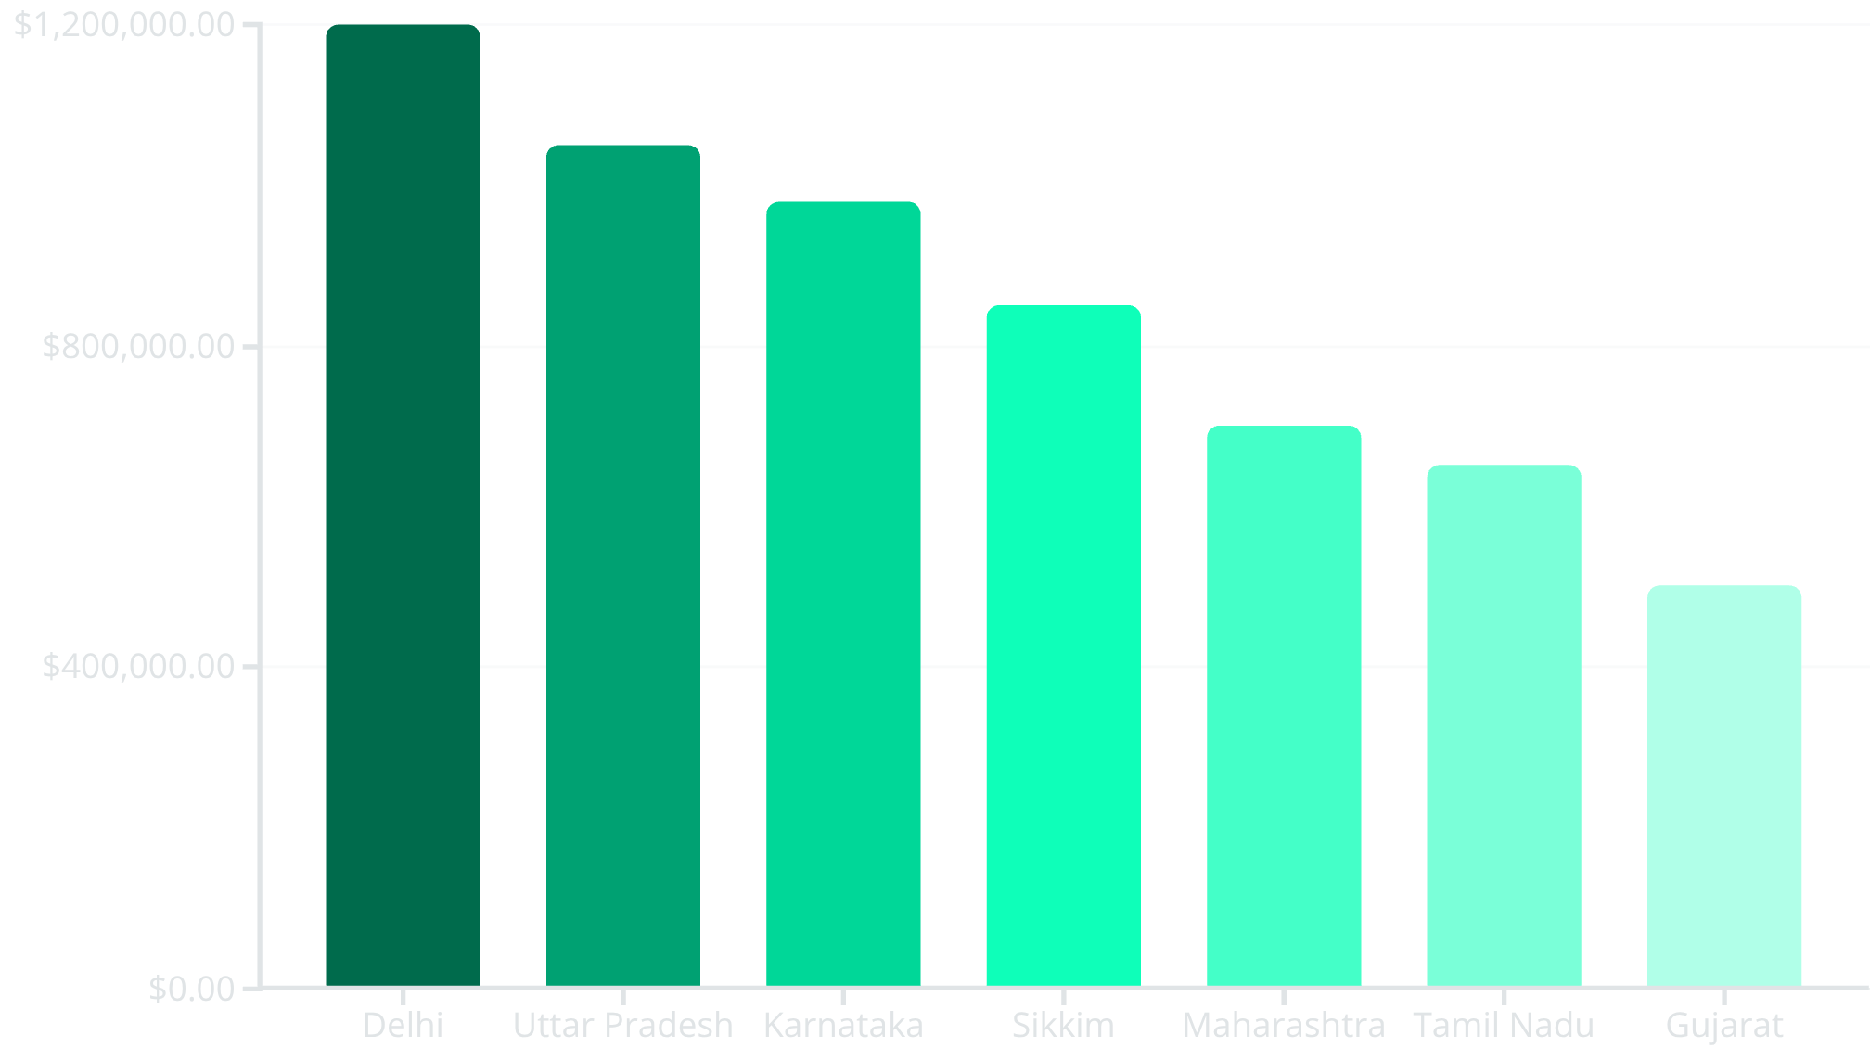

Geographical Premium Contribution by State
Analyzing premium contributions by state provides critical geographical insights, allowing us to identify regional strengths and areas requiring targeted intervention. This understanding informs localized marketing strategies and resource allocation.
Key Insight
The states of Delhi, Uttar Pradesh, Karnataka, and Sikkim are our strongest markets, consistently generating the highest premiums. This indicates a high penetration or strong market acceptance in these regions, offering opportunities for further expansion and focused campaigns.
Conversely, this data also highlights states where market presence might need strengthening or where different sales approaches could yield better results.

Slide 11
Premium Contribution by Occupation Segment
Key Insight
High-paying professions such as IT Professionals, Medical Practitioners, Architects, and Business Owners represent significant premium contributions. Targeting these segments with tailored insurance products could further enhance our market share and premium revenue.
Understanding the occupational breakdown of our policyholders allows us to fine-tune our product offerings and marketing messages to resonate more effectively with specific professional groups. This demographic insight is vital for precision targeting.
By focusing on the needs and financial capacities of these high-value segments, we can develop specialized policies that cater to their unique requirements, ensuring higher conversion rates and customer satisfaction

Slide 12


